Slide 1

Exploration of FDI in INDONESIA with LASSO Machine learning techniques
Mathew Attipetty

Slide 2

Personally, I prefer a liberal dictator to democratic government lacking liberalism - Friedrich Hayek

Slide 3
Research Question
What variables in a predictive model affect the inflows of FDI in Indonesia during the periods of 1965-2000 using machine learning techniques such as Least absolute shrinkage and selection operator (LASSO) ?

Slide 4
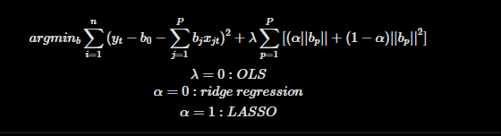
Quick background to LASSO
Regularization technique used in linear regression to improve model performance and feature selection
Applies a penalty term to the regression coefficients, which shrinks some coefficients to zero. This results in sparse models that select only the most relevant features
Ability to shrink coefficients to zero makes it useful for feature selection, as it helps identify the most important variables that contribute to the prediction task.

Slide 5
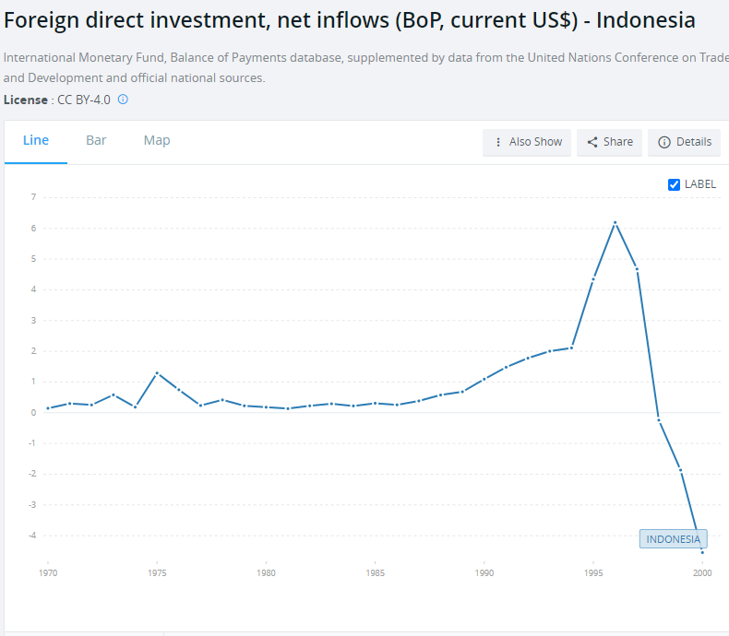
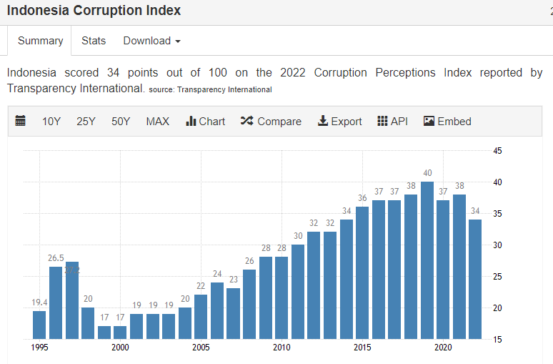
Why Indonesia?

Slide 6
Variable of interest
GDP growth (annual %)
Inflation, GDP deflator: linked series (annual %)
Real interest rate (%),
Official exchange rate (LCU per US$, period average),
Trade (% of GDP),
Total reserves (% of total external debt)
Foreign direct investment, net inflows (% of GDP)

Slide 7
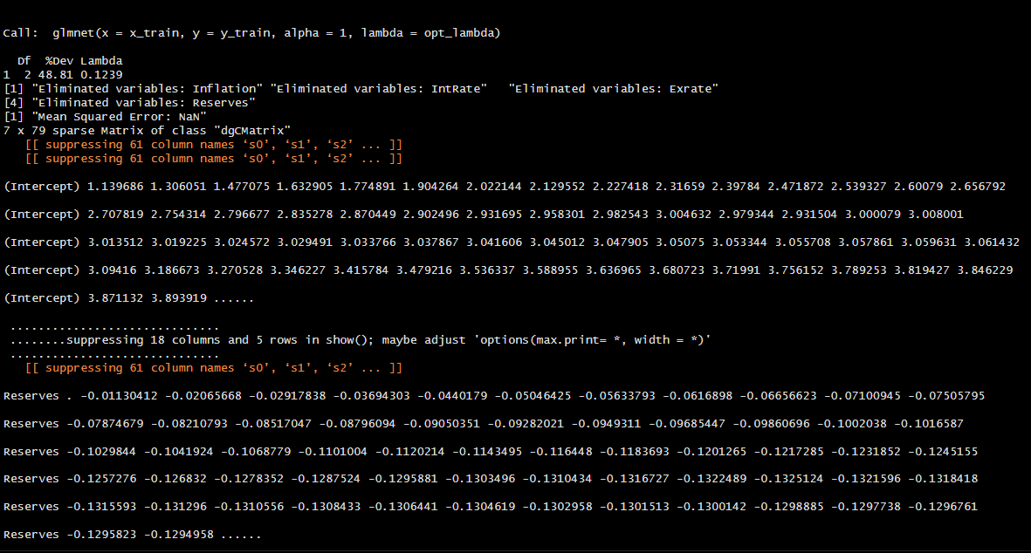
Results

Slide 8
Something is going on with these investors
“…the Indonesian Paiton project (a 1,200-megawatt electricity plant) completed in 1999 with the strong support of U.S.Ambassador Barry and President Clinton, at a cost of $2.5 billion. Many things were clearly wrong. First, relatives of President Suharto received a $50 million loan from American companies, which was to be repaid out of dividends that were unlikely to be paid. More importantly, since the Indonesian investors — who were involved with President Clinton — also controlled the supply of coal to the plant, they were able to price it at levels that made the plant uneconomic. Thirdly, the cost of the plant was well over twice the cost of a similar power facility anywhere else in the world, and anyone with a modicum of electric power experience would have known the cost did not make sense. Fourth, the cost of power was higher than prevailing electricity rates. Lastly, the price of power was in U.S. dollars — since devaluations were a well-known major risk in Indonesia over the past two decades, this meant in local currency terms the power would be priced out of the market with a devaluation. The plant closed and was bankrupt when it was completed,”

Slide 9
“Although some economists have argued that the New Order created local capitalism, in most cases business empires were not established through investment, but by forceful appropriation…..Economists, Indonesian and foreign, duly endorsed the resulting (economic growth) figures as indicators of the New Order’s success.” (187 A History of Modern Indonesia)
-Adrian Vickers

Slide 10
Questions/suggestions?

